Slide 1
ENV 415 / ATM 415 Climate Laboratory
Spring 2016

Slide 2
What is a climate model?
In the broadest sense, models are for learning about the world (in our case, the climate) and the learning takes place in the contruction and the manipulation of the model, as anyone who has watched a child build idealised houses or spaceships with Lego, or built with it themselves, will know. Climate models are, likewise, idealised representations of a complicated and complex reality through which our understanding of the climate has significantly expanded. All models involve some ignoring, distoring and approximating, but gradually they allow us to build understanding of the system being modelled. A child's Lego construction typically contains the essential elements of the real objects, improves with attention to detail, helps them understand the real world, but is never confused with the real thing.
The Climate Modelling Primer (4th ed), McGuffie & Henderson-Sellers, page 6

Slide 3
Or another way to phrase it…
All models are wrong, but some are useful.
Box and Draper (1987), Empirical Model-Building and Response Surfaces.

Slide 4
A minimal definition of a climate model:
A representation of the exchange of energy between the Earth system and space, and its effects on average surface temperature

Slide 5
Trenberth and Fasullo (2012) Surv. Geophys.

Slide 6
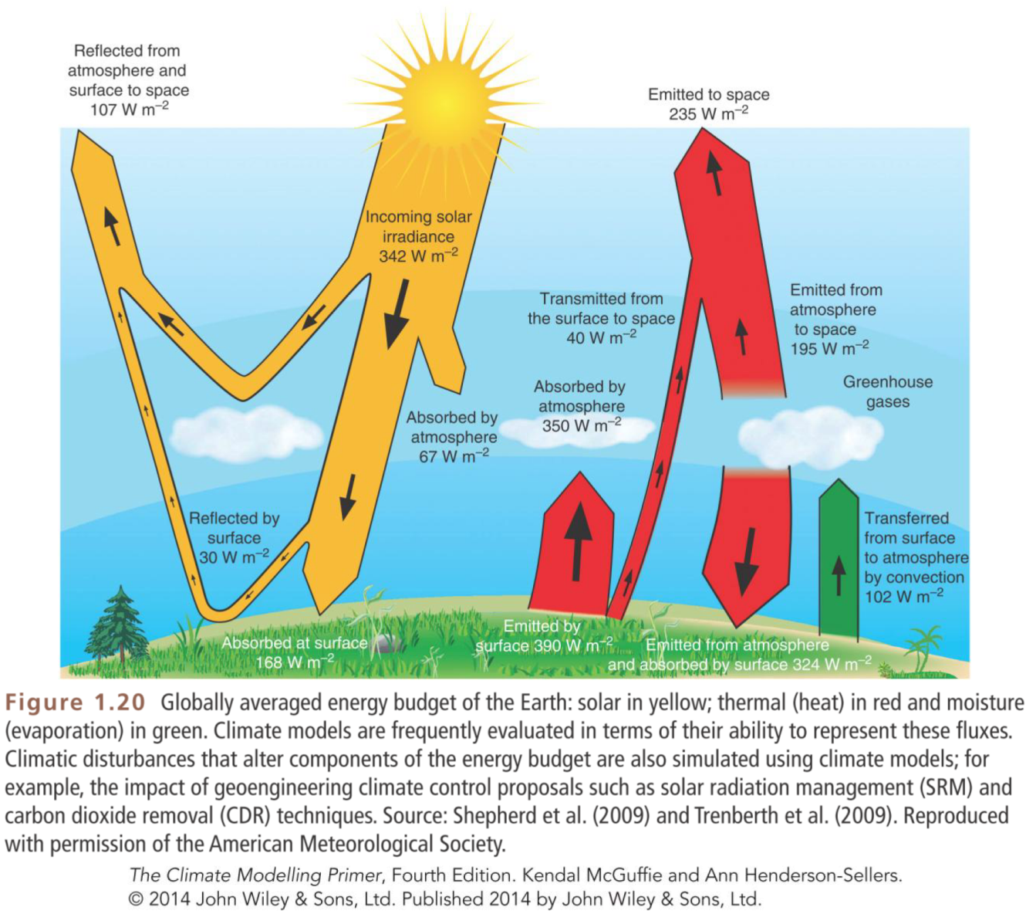
Companion website: www.wiley.com/go/mcguffie/climatemodellingprimer

Slide 7
Definition of the “climate system”:
From the IPCC AR5 report
“The climate system is the highly complex system consisting of five major components: the atmosphere, the hydrosphere, the cryosphere, the lithosphere and the biosphere, and the interactions between them. The climate system evolves in time under the influence of its own internal dynamics and because of external forcings such as volcanic eruptions, solar variations and anthropogenic forcings such as the changing composition of the atmosphere and land use change.”

Slide 8
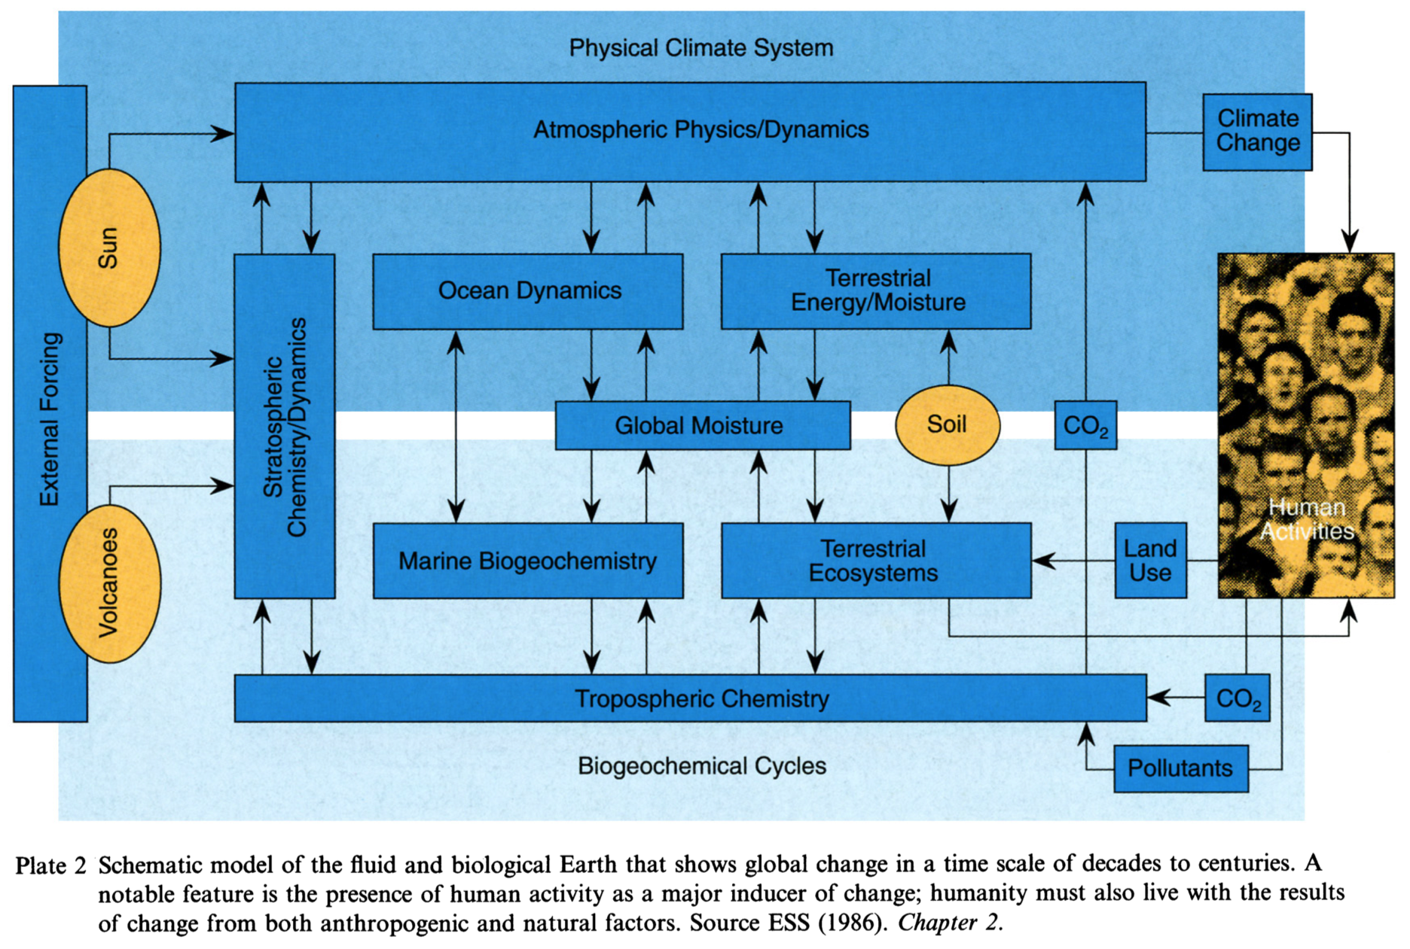
Climate System Modeling, K. Trenberth (ed.)

Slide 9
Climate Change 2013: The Physical Science Basis (IPCC)

Slide 10
Climate Change 2013: The Physical Science Basis (IPCC)

Slide 12
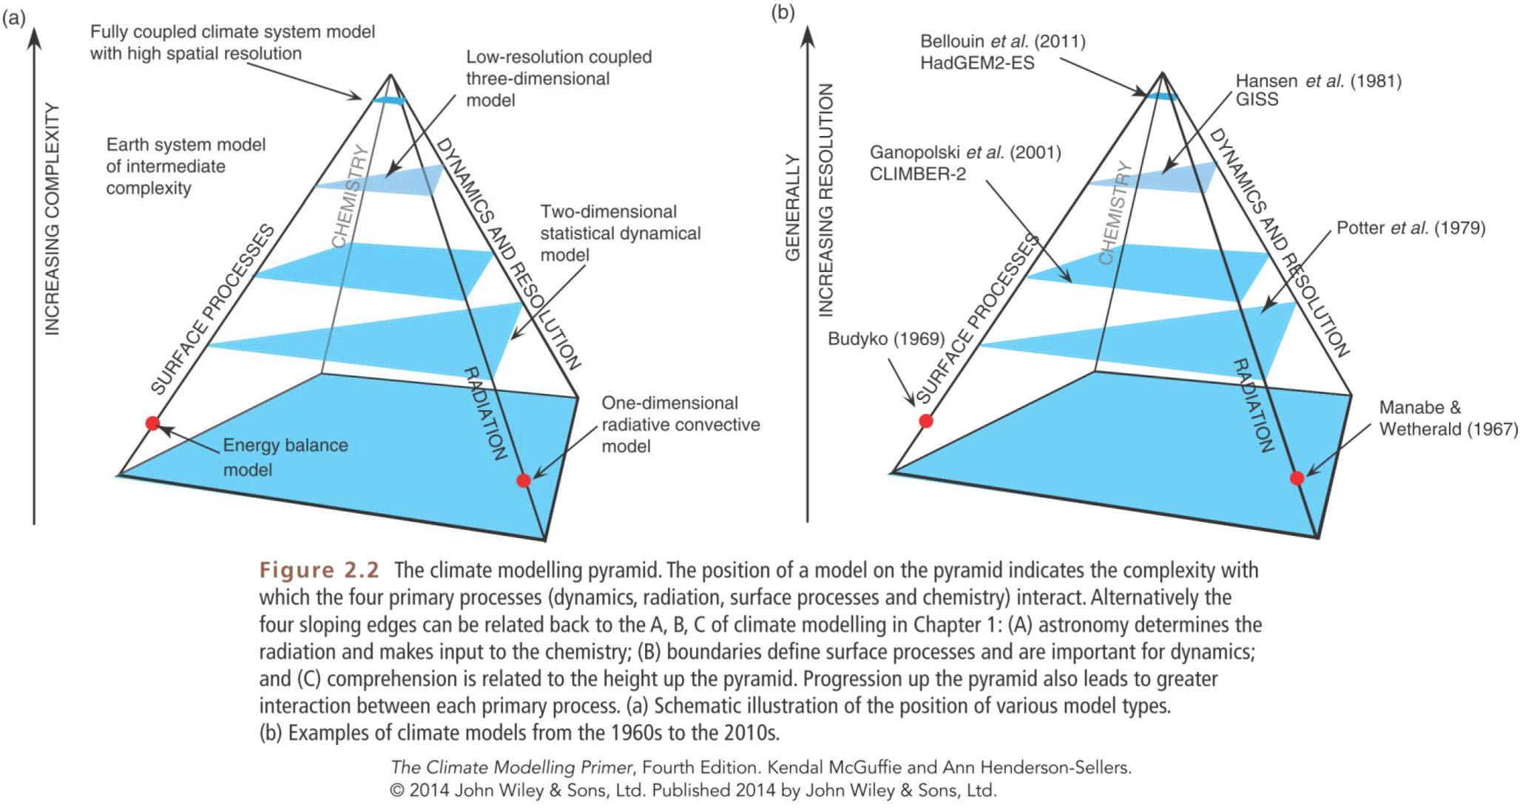
Companion website: www.wiley.com/go/mcguffie/climatemodellingprimer

Slide 14
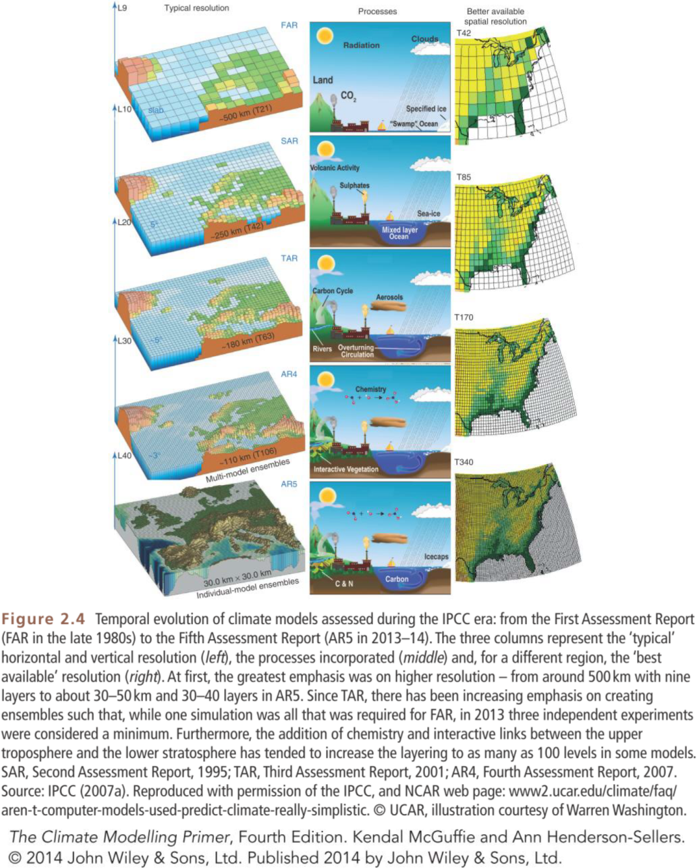
Companion website: www.wiley.com/go/mcguffie/climatemodellingprimer

Slide 15
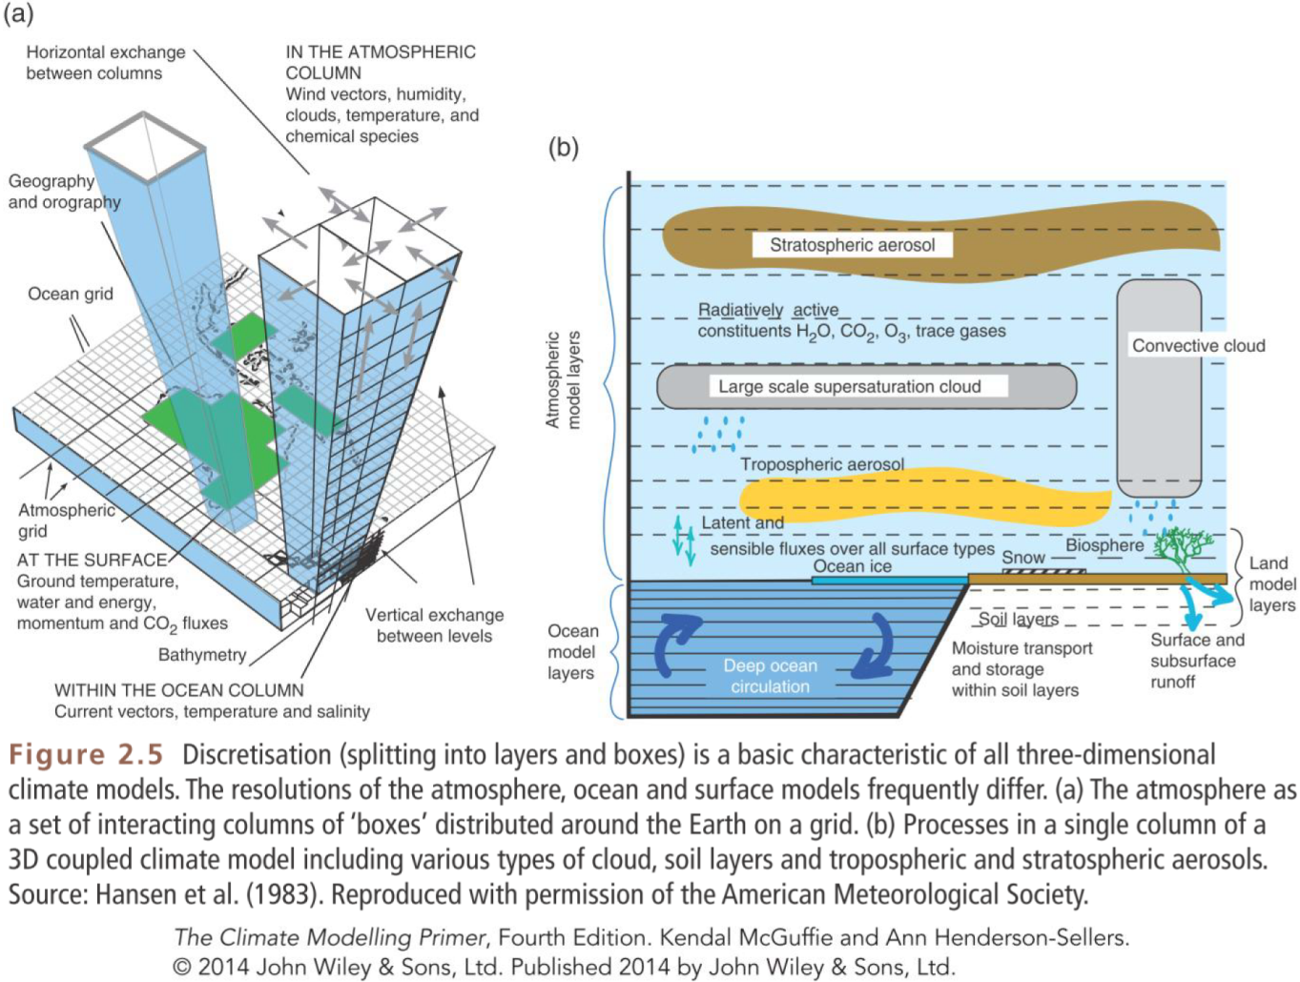
Companion website: www.wiley.com/go/mcguffie/climatemodellingprimer

Slide 16
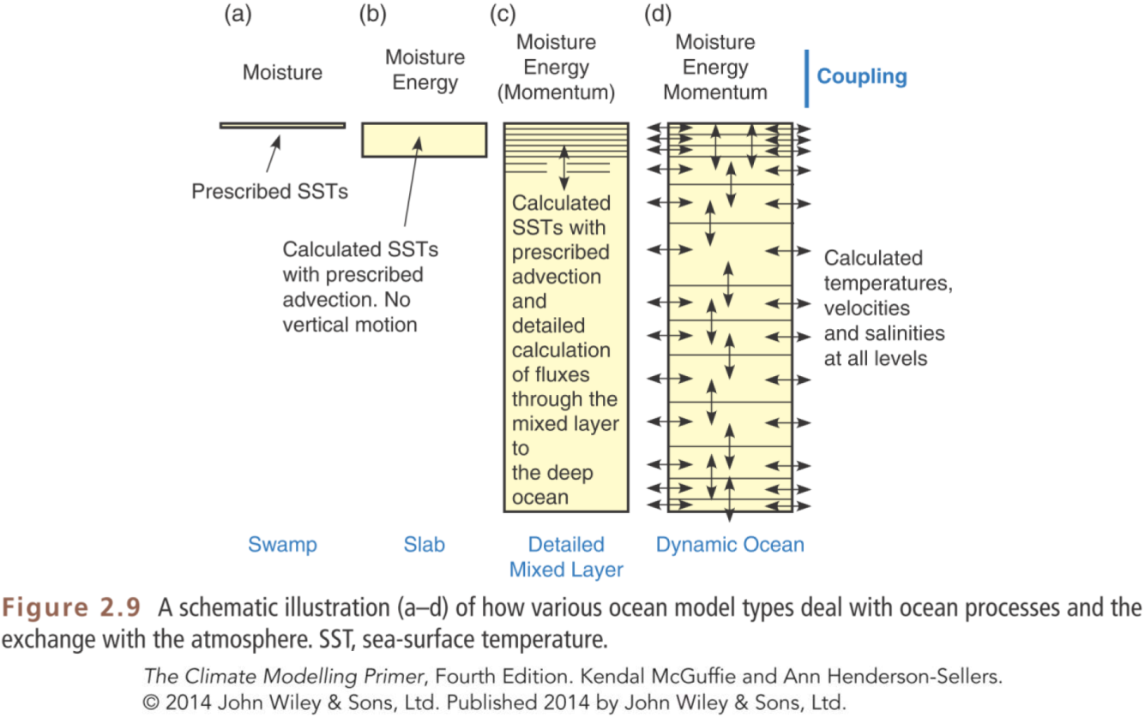
Companion website: www.wiley.com/go/mcguffie/climatemodellingprimer

Slide 17
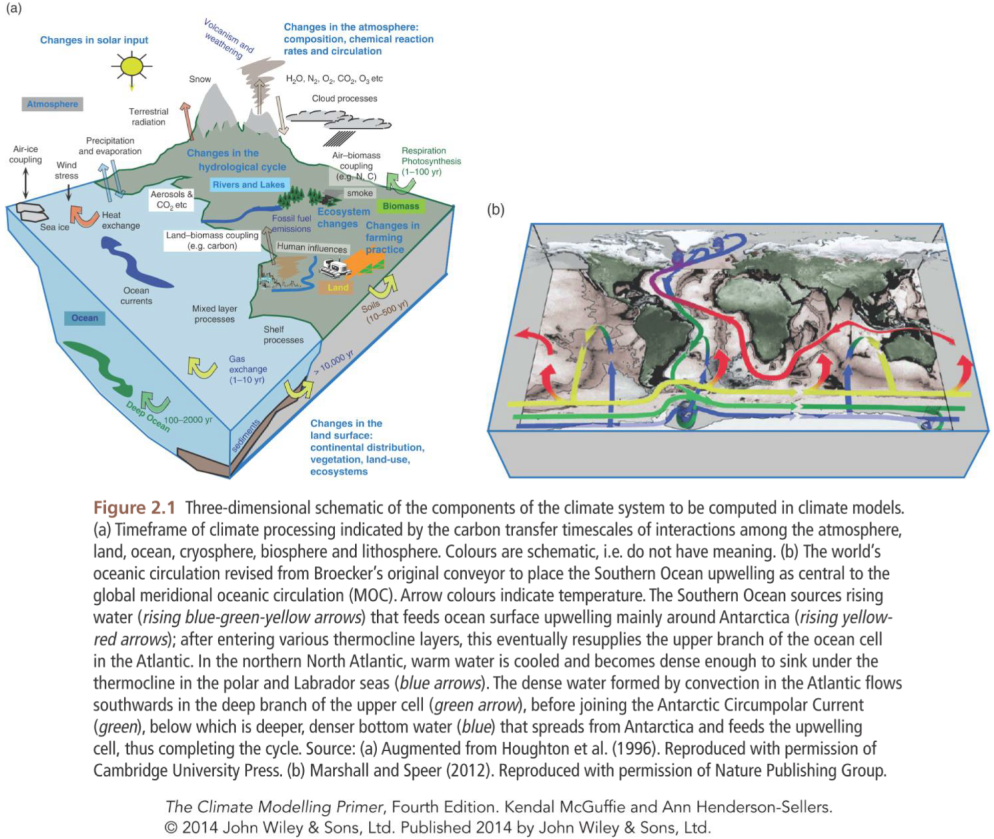
Companion website: www.wiley.com/go/mcguffie/climatemodellingprimer

Slide 18
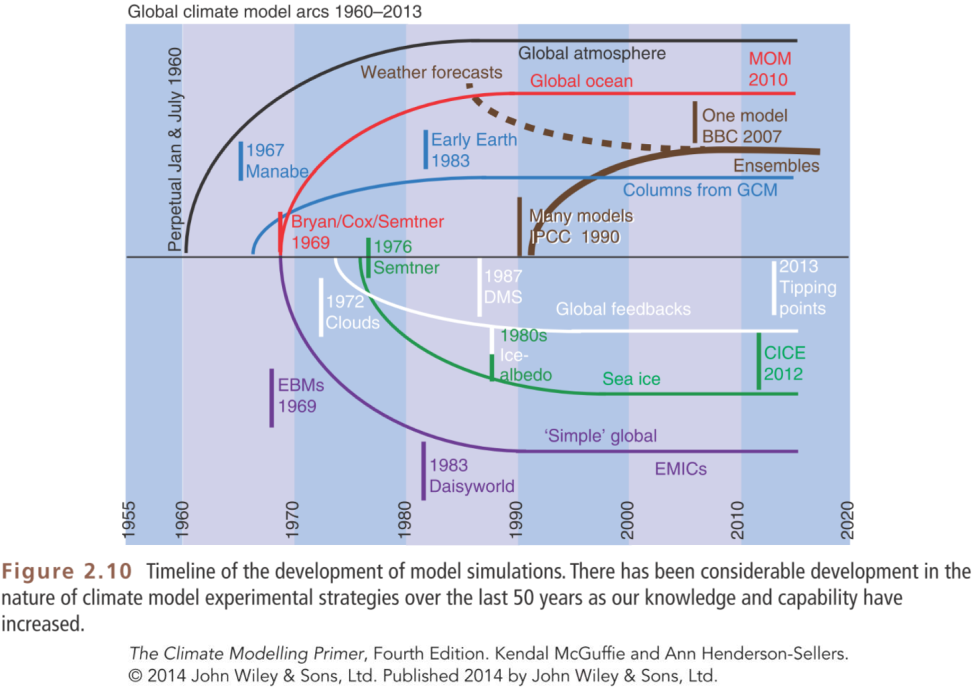
Companion website: www.wiley.com/go/mcguffie/climatemodellingprimer

Slide 19
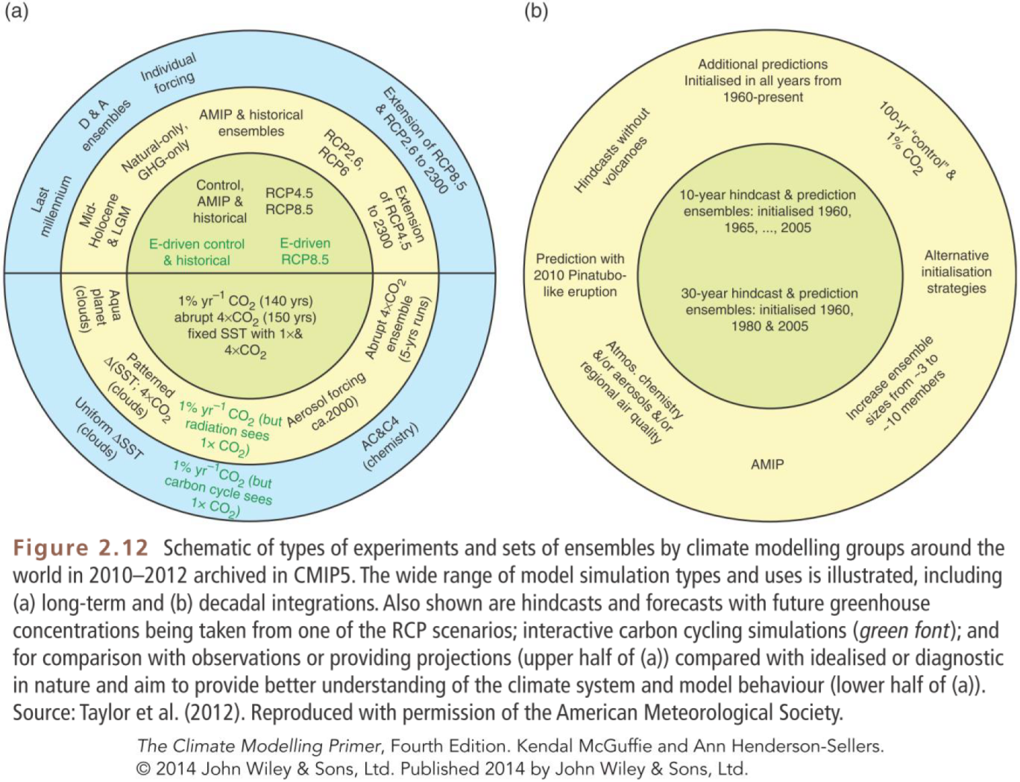
Companion website: www.wiley.com/go/mcguffie/climatemodellingprimer

Slide 20
The feedback concept
gain
process
input
output

Slide 21
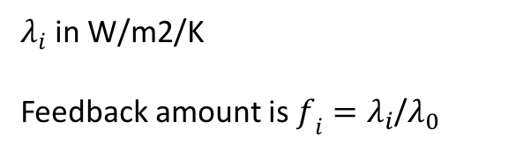
Feedback parameters estimated from GCMs
$λ_{i}$ in W/m2/K
Feedback amount is $f_{i}=λ_{i}$/$λ_{0}$
From Soden and Held (2006) J. Climate

Slide 22
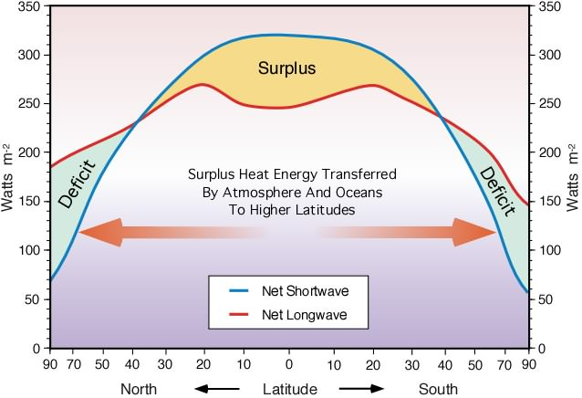
Annual Radiation Balance
The meridional gradient in Absorbed Solar Radiation (ASR) drives circulation.

Slide 25
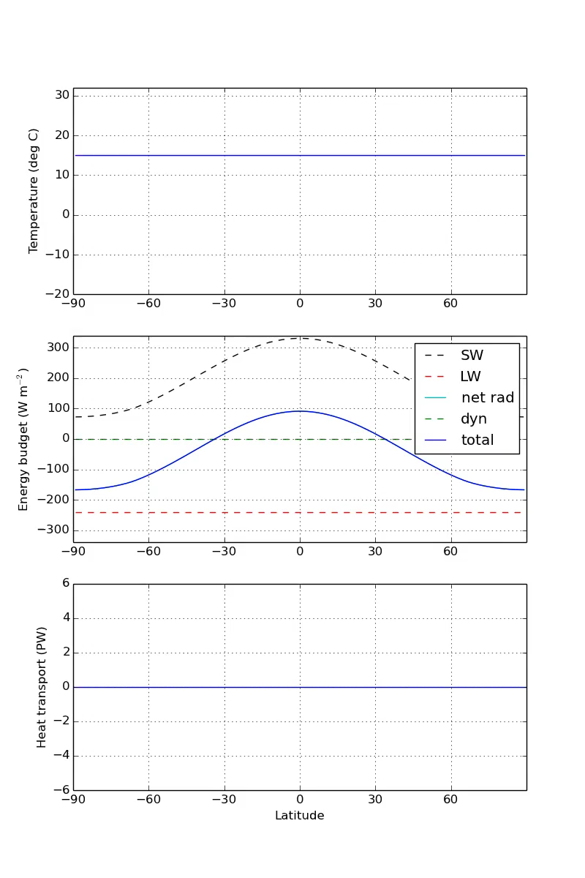
Adjustment to equilibrium in the EBM 1D annual mean model with heat transport

Slide 27
Snowball Earth
Extensive evidence for large glaciers at sea level in the tropics! Evidently climate was very cold at these times.

Slide 28
Snowball Earth

Slide 29
Snowball Earth
Various bizarre features in the geological record from 635 and 715 Ma ago indicate that the Earth underwent some very extreme environmental changes… at least twice.
The Snowball Earth hypothesis:
The Earth was completely ice-covered (including the oceans)
The total glaciation endured for millions of years
CO2 slowly accumulated in the atmosphere from volcanoes
Weathering of rocks (normally acting to reduce CO2) extremely slow due to cold, dry climate
Eventually the extreme greenhouse effect is enough to melt back the ice
The Earth then enters a period of extremely hot climate.
The hypothesis rests on a phenomenon first discovered by climate modelers in the Budyko-Sellers energy balance models: runaway ice-albedo feedback.

Slide 30
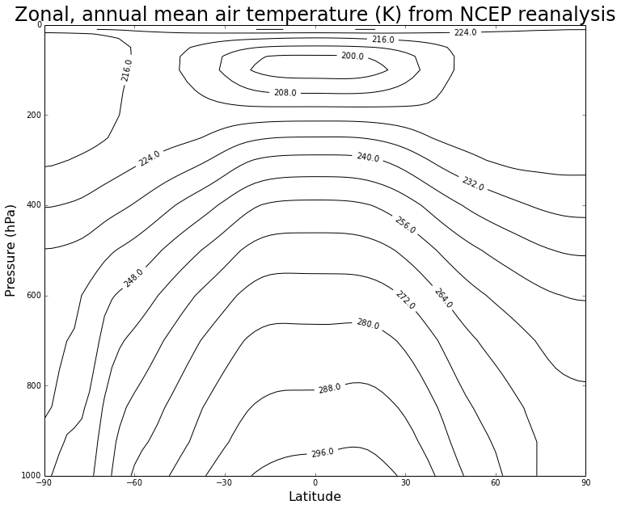
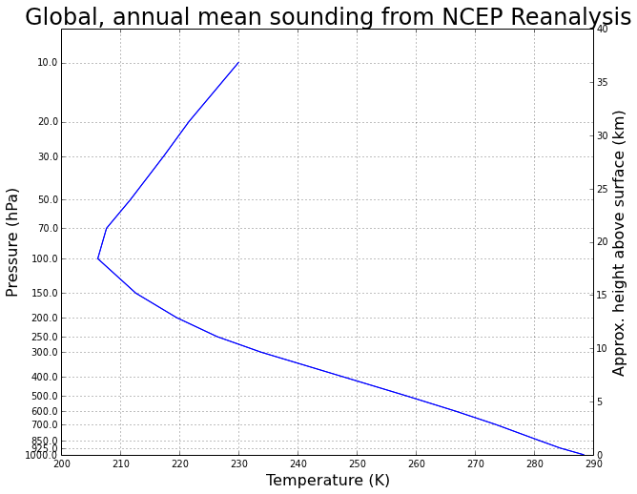

Slide 32
Marshall and Plumb (2007), Atmosphere, Ocean, and Climate Dynamics

Slide 33
Marshall and Plumb (2007), Atmosphere, Ocean, and Climate Dynamics

Slide 34
Radiative forcing scenarios

Slide 35
GHG concentrations / emissions in different scenarios

Slide 37
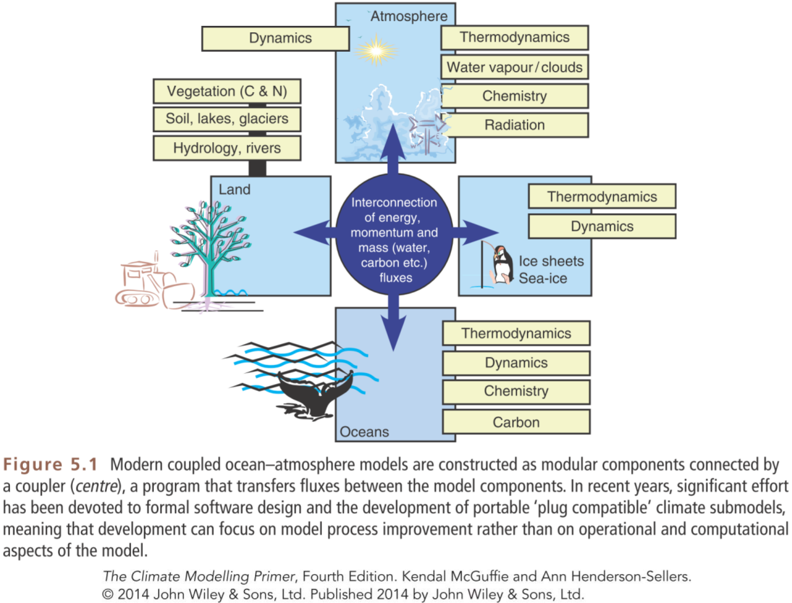
Companion website: www.wiley.com/go/mcguffie/climatemodellingprimer

Slide 38
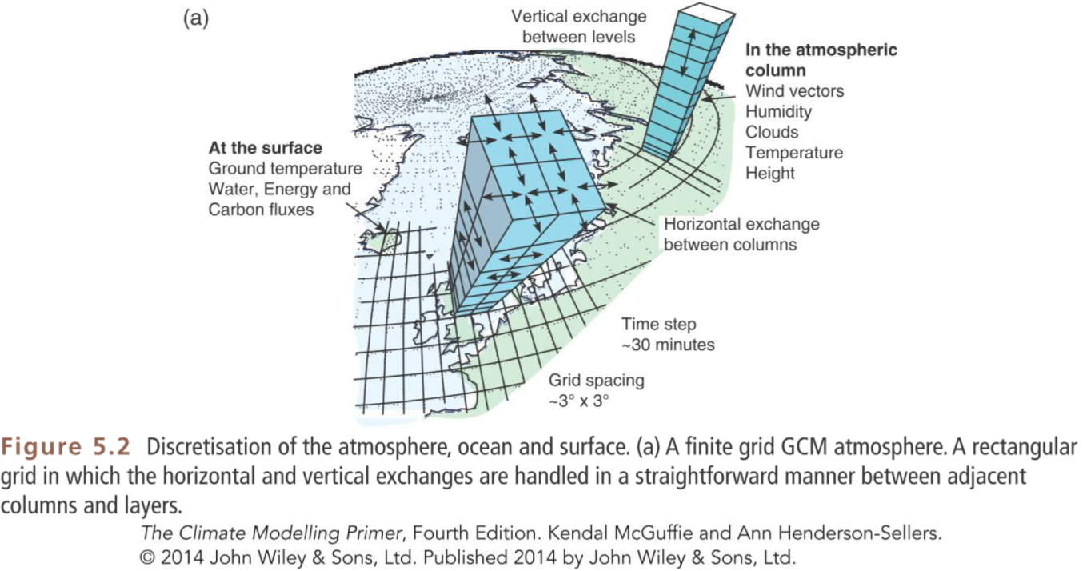
Companion website: www.wiley.com/go/mcguffie/climatemodellingprimer

Slide 39
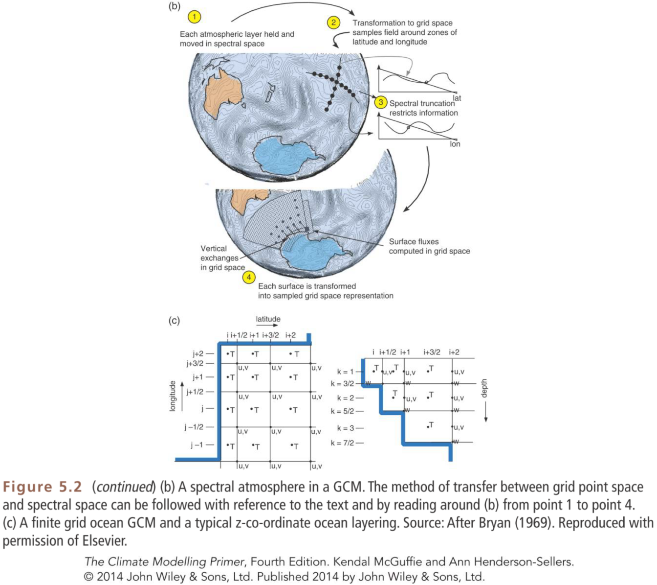
Companion website: www.wiley.com/go/mcguffie/climatemodellingprimer

Slide 40
Companion website: www.wiley.com/go/mcguffie/climatemodellingprimer

Slide 41
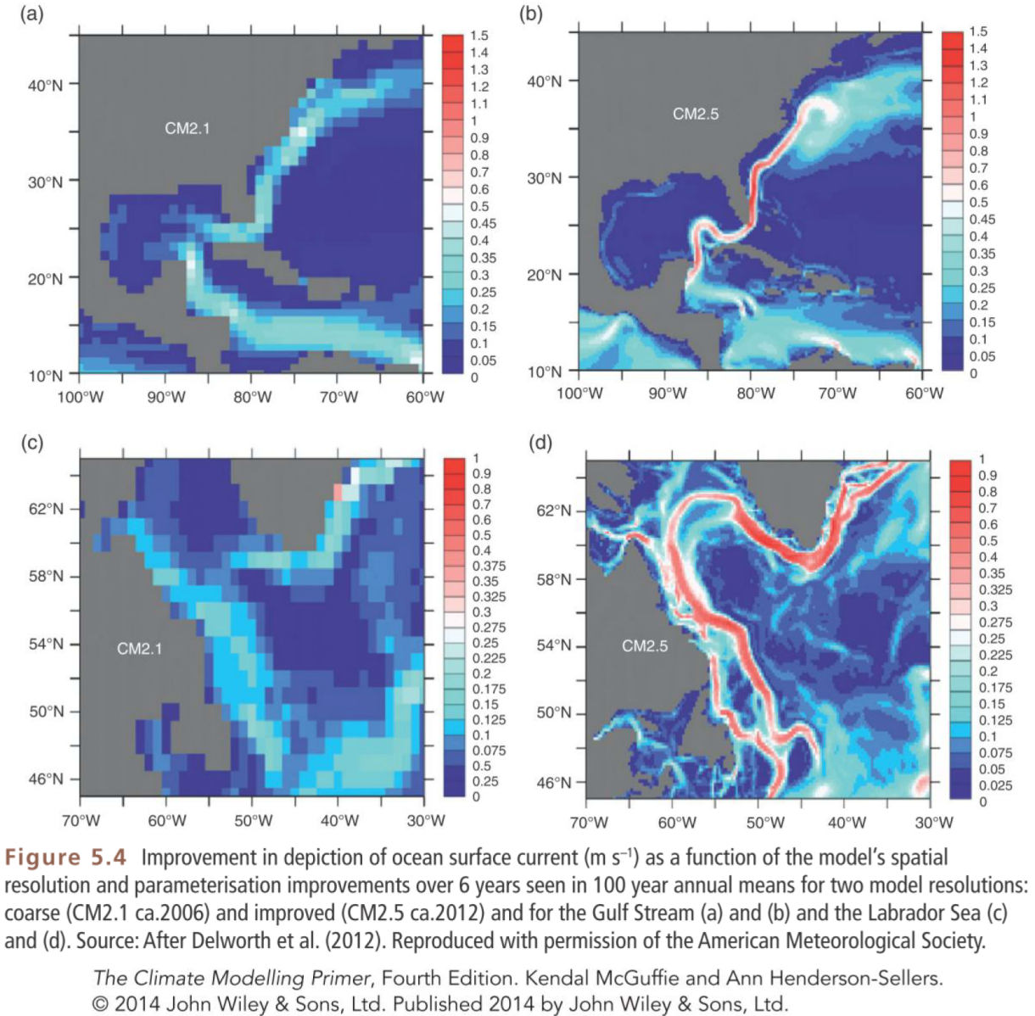
Companion website: www.wiley.com/go/mcguffie/climatemodellingprimer

Slide 42
Webster (1994), The role of hydrological processes in Ocean-atmosphere interactions. Rev. Geophys. 32

Slide 43
Radiative forcing scenarios

Slide 44
GHG concentrations / emissions in different scenarios

Slide 45
CMIP5 experimental design

Slide 48
Global mean temperature changes

Slide 49
Normalized changes per degree global warming

Slide 51
Energy budget in CMIP5 simulations

Slide 52
Feedback and climate sensitivity in CMIP5 models

Slide 53
Equilibrium Climate Sensitivity and Transient Climate Response

